Slide 1

Student Management System
Presented By :-
Group : 11
Akash K. Yadav && Shivanshu Singh

Slide 2
Introduction
Student Management System(SMS) Can handle all the Operations related to Institute Management regarding students and teachers. The details include college/school details, Students details, Teachers details, Academic details, Feedback, etc..
The SMS involves :-
Registrations
Manage Fees structure
Scheduling of classes, exams,etc
Result Management
Adding new curriculum
Assignment submission
Feedback system
And many more..

Slide 3
OBJECTIVES :-
SMS is a Management Information System for Educational Establishments to manage student data.
These systems work to coordinate scheduling and communications between faculty regarding students.
Provide Faster way to get information about the students.
Ensure Data Integrity, Privacy, and Security in an open-access environment.

Slide 4
Tools Used
Front End : VS Code
Back End : Spring Tool Suite(STS)
DATABASE : MySQL

Slide 5
Technology Used
Spring Boot
Spring Boot is an extension of Spring, which eliminates the boilerplate configurations required for setting up a Spring application.
In Spring Boot, everything is auto configured; no manual configurations are needed.
It offers annotation-based spring application.
Starters take care of dependencies.
Allow us to building Standalone applications

Slide 6
Continue….
Reactjs :-
React JS is basically a JavaScript library built and maintained by Facebook. According to the creator of React JS, Jordan Walke, React is an efficient, declarative, and flexible open-source JavaScript library for building simple, fast, and scalable frontends of web applications.
Compared to other frontend frameworks, the React code is easier to maintain and is flexible due to its modular structure.
The core of the framework offers a virtual DOM program and server-side rendering, which makes complex apps run extremely fast.
One of the main benefits of using React JS is its potential to reuse components

Slide 7
Continue….
MySQl :-
Open-source and compatible.
Fast and reliable.
Availability.
Scalability.
Security

Slide 8

User Classes
Admin
Teacher
Student
In this module Admin, which can be our Institute director can register, update details, check students feedback regarding teachers, and can also provide salaries to its staff, and many more.
In this module Teacher can update their profile, add assignment, view schedule, marksheets, check feedback, take online attendance, etc
In this module Student, who can update his profile, submit assignment, check schedule, pay fees, view marksheet, view attendance,
etc

Slide 9
Product Functions
01
The system provides efficient way to use the services by Teachers, Students, and their Parents.
The system provides easy interface for Student, who can easily send their feedback related to teachers style of teaching and methodology.
02
03
The Payments paid or received can also be managed and recorded through SMS.
Reporting feature benefits the Institute to analyze the students behavior and examine the outcomes to boost their performance.
04
05
Parents can access and easily monitor their children's performance and ongoing school activities, including homework, project submission, attendance, etc.,

Slide 10
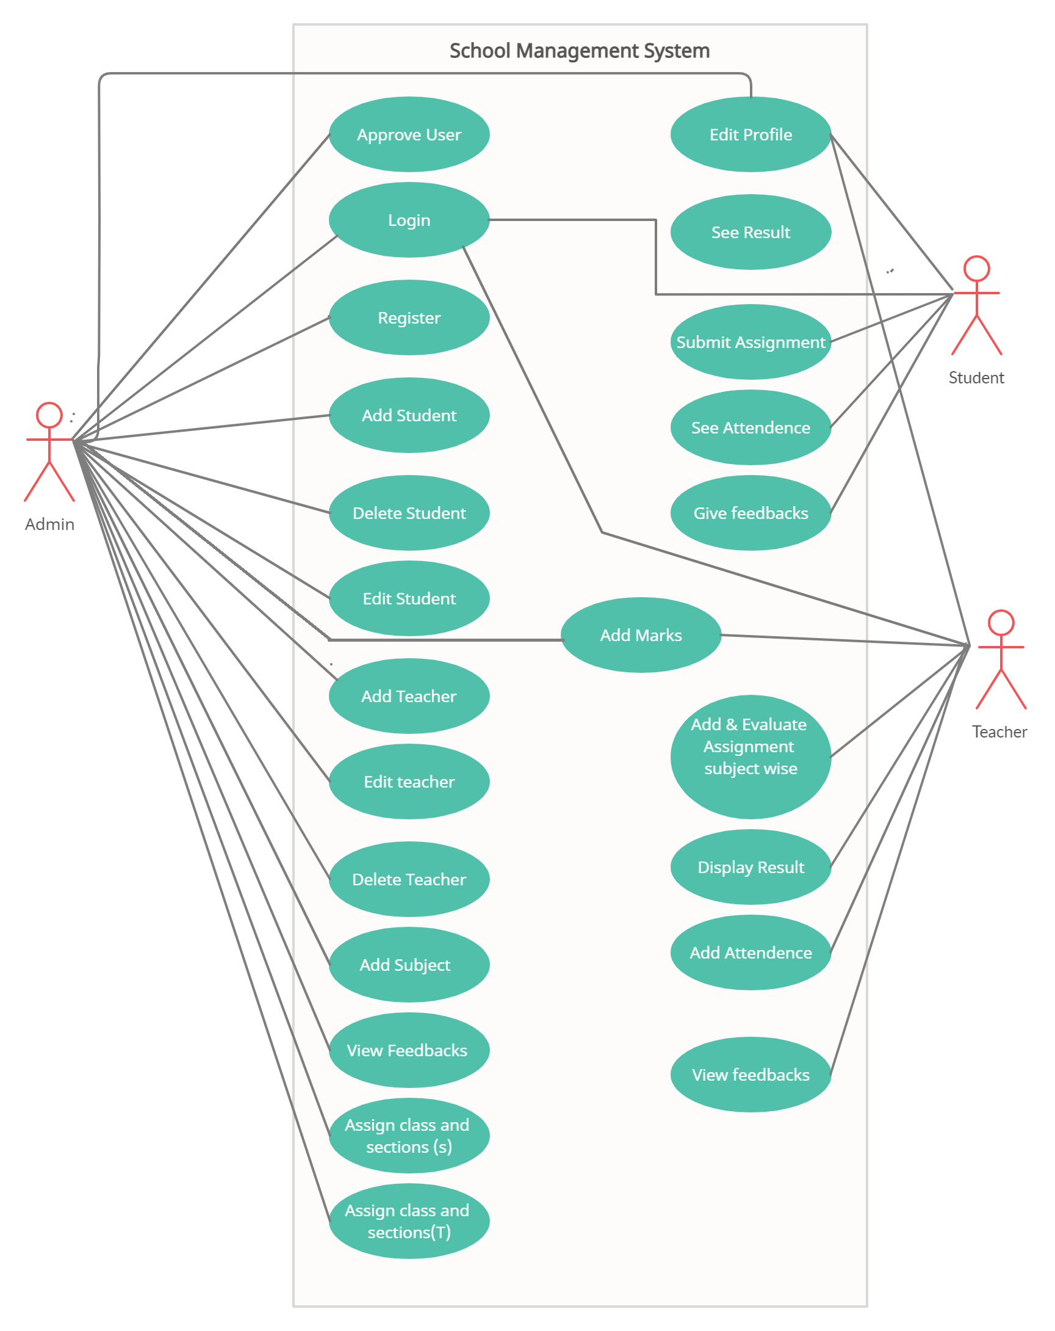
Use Case diagram

Slide 11
Admin Module
After successful registration and authentication from Admin :-
Can Update his profile after successful authentication.
Add new curriculum.
Register teacher and students.
Can create course schedule.
Can Manage institute finances.
can access student and teachers details.

Slide 12
Teacher Module
After successful registration and authentication from Teacher :-
Can Update his profile after successful authentication,
Can view his course schedule.
Upload Marks
View And Mark Attendance of students.
Add Assignment.

Slide 13
Student Module
After successful registration and authentication from Student can :-
Can Update his profile after successful authentication,
Can view his course schedule.
Can pay institute fees.
Check Marks and rank
View history of his/her Attendance.
Submit Assignment.

Slide 14
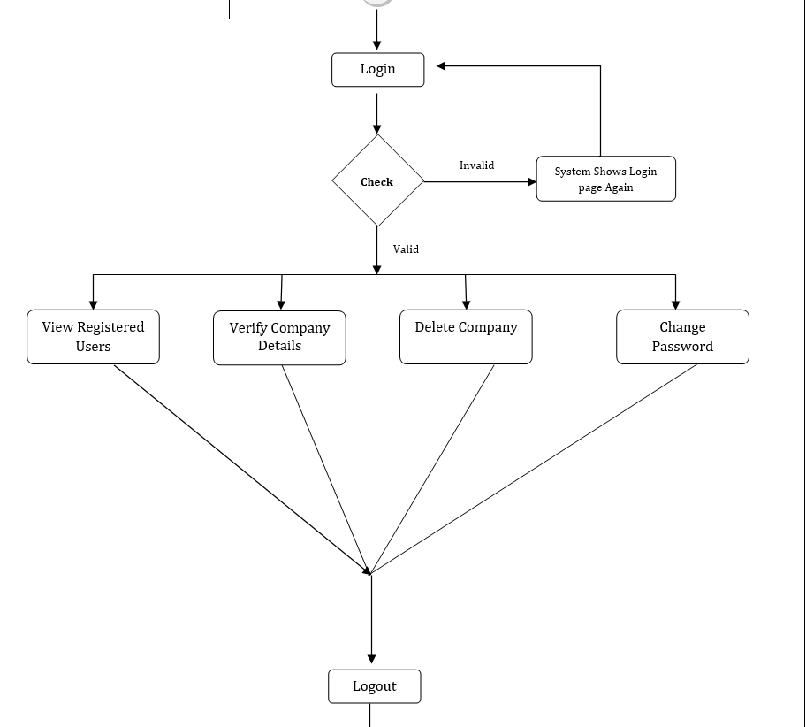
Activity Diagram : Admin

Slide 15
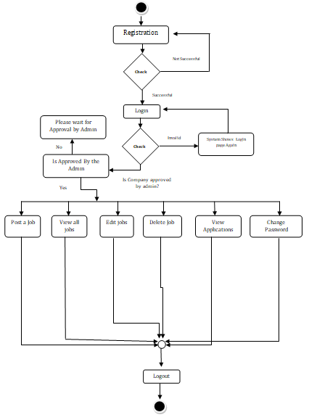
Activity Diagram : Company

Slide 16
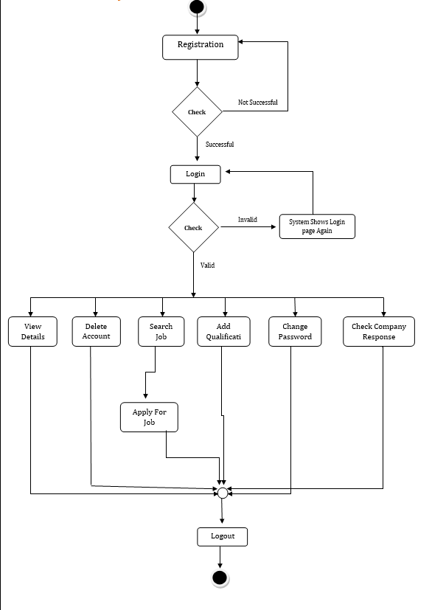
Activity Diagram : User

Slide 17
Admin Page flow

Slide 18
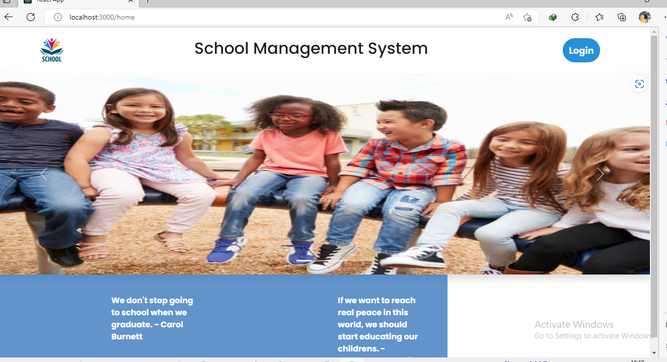

Slide 19
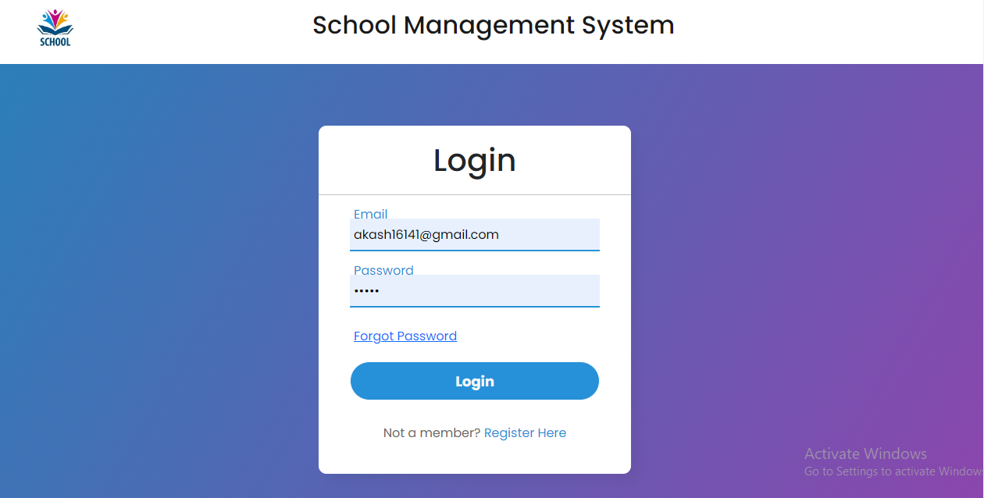

Slide 20
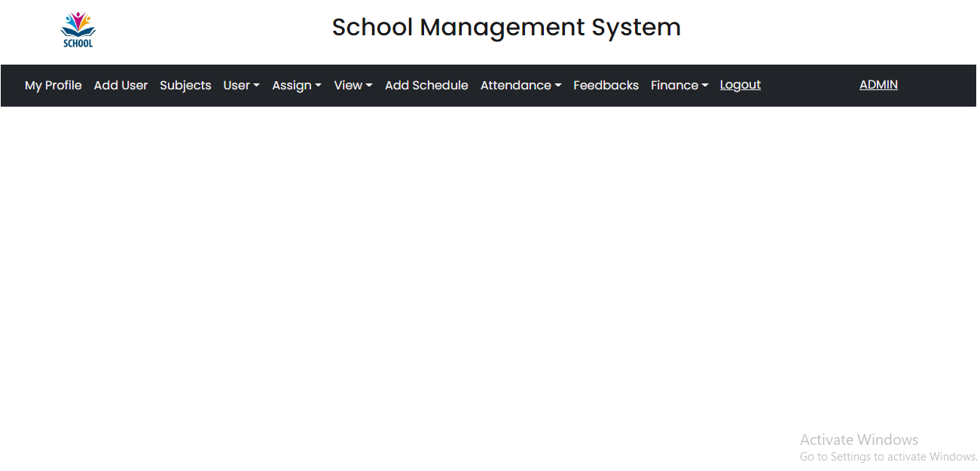

Slide 21
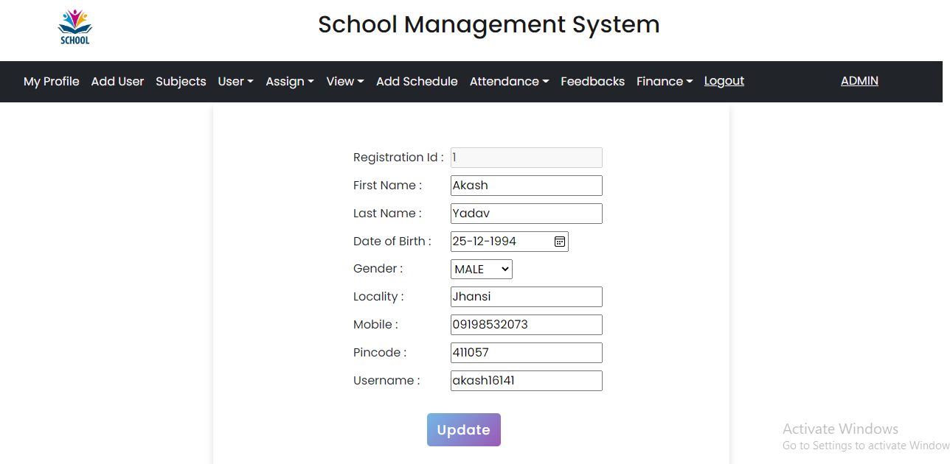

Slide 22
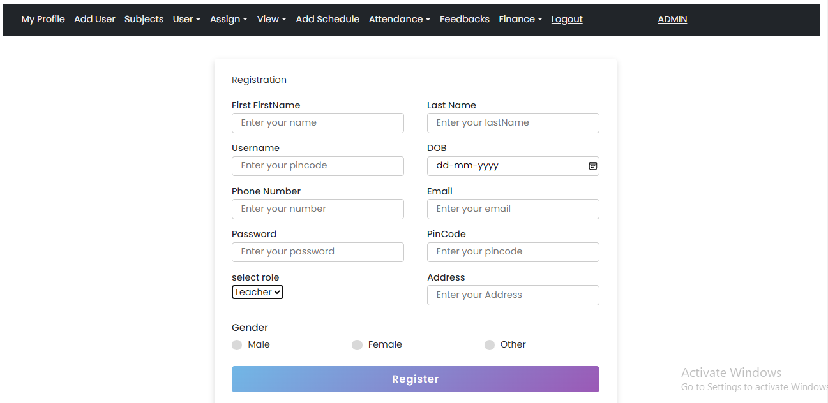

Slide 23
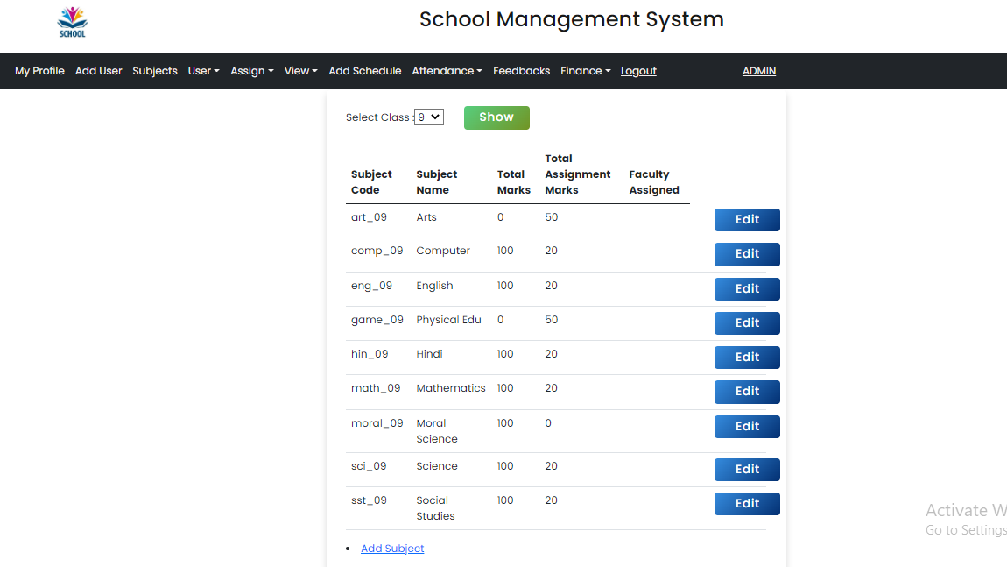

Slide 24
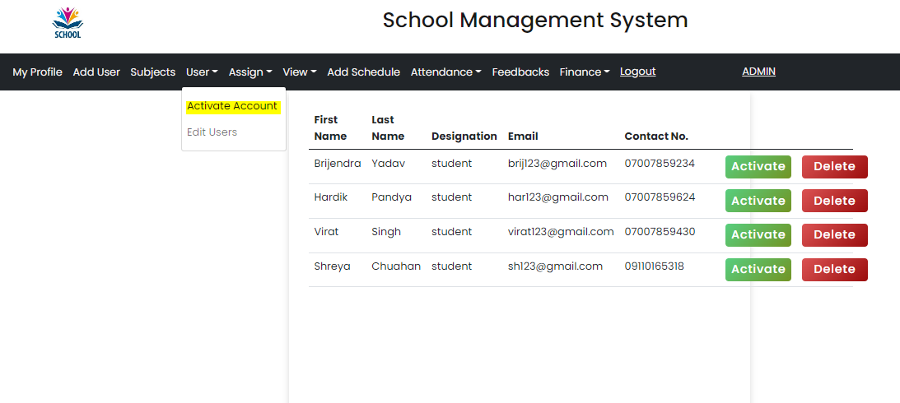

Slide 25
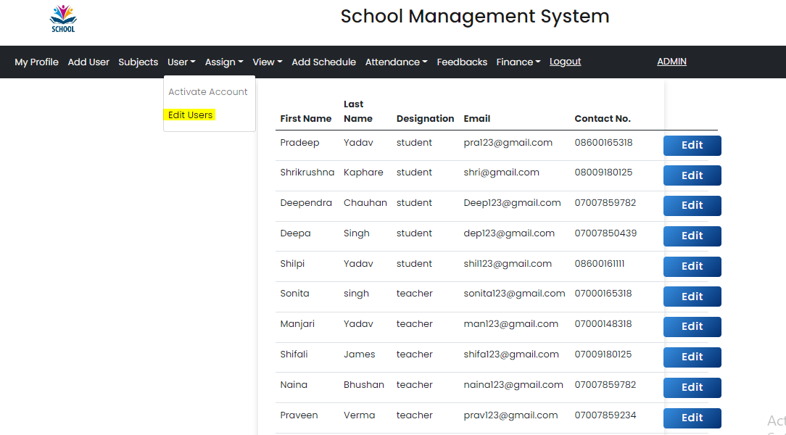

Slide 26
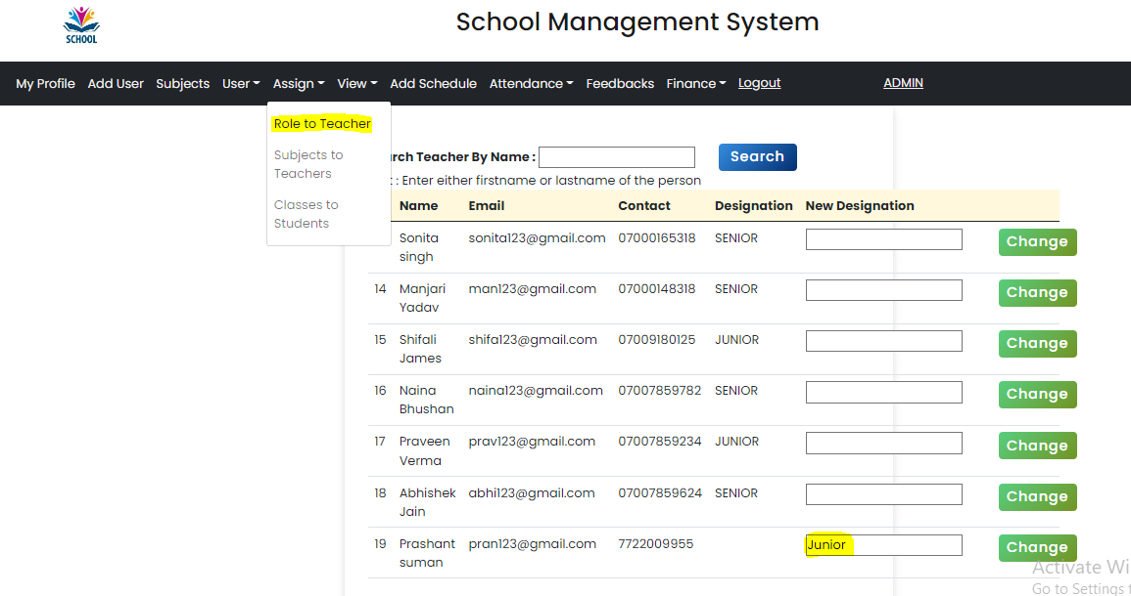

Slide 27
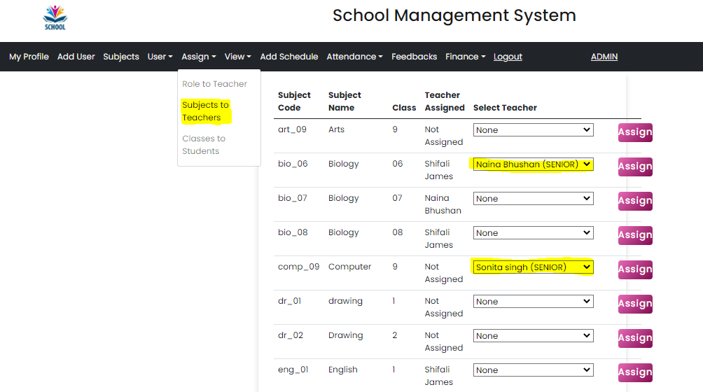

Slide 28
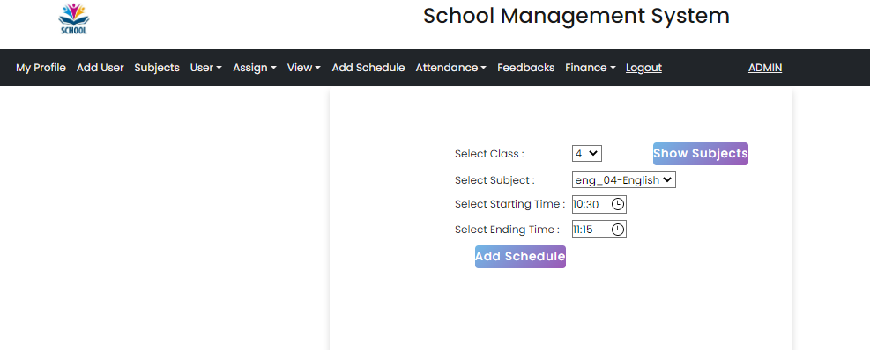

Slide 29
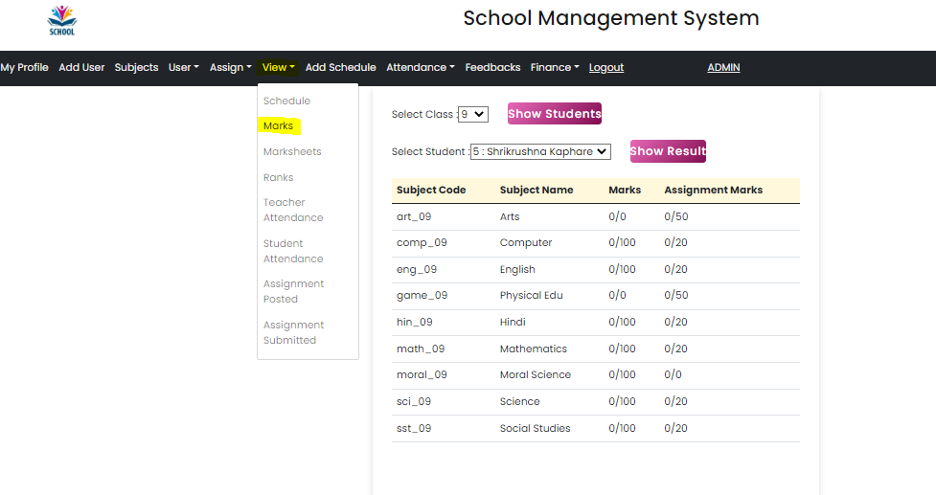

Slide 30
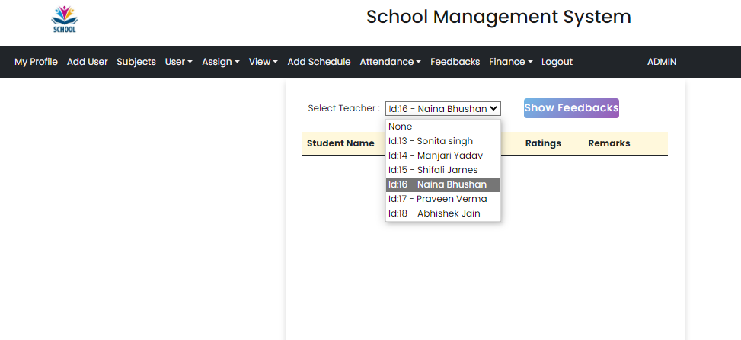

Slide 31
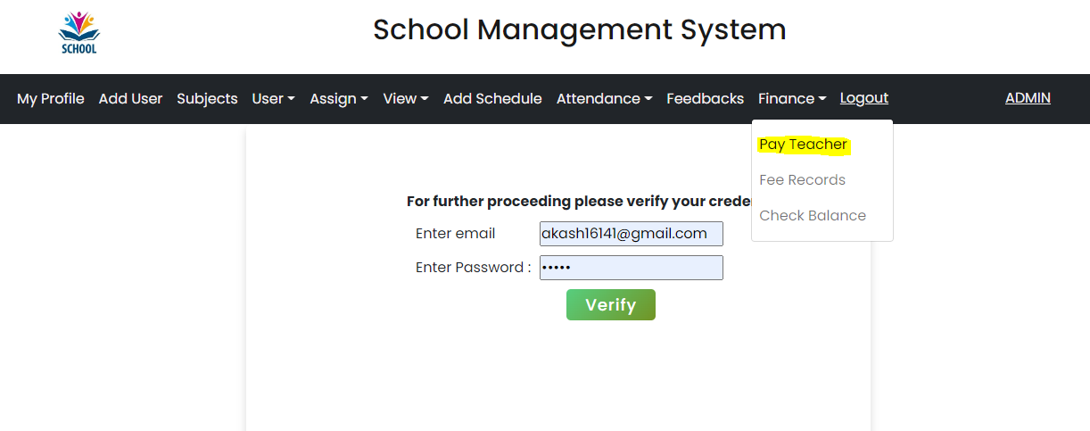

Slide 32
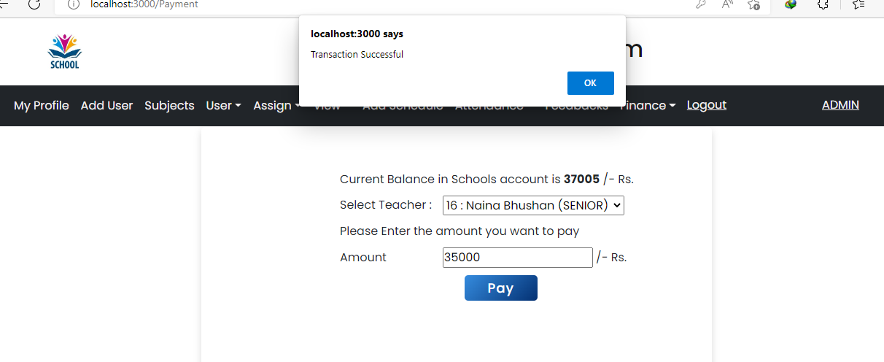

Slide 33
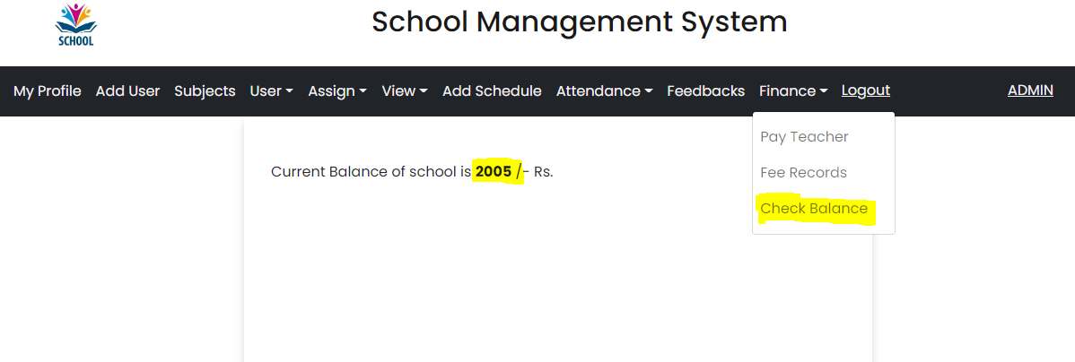

Slide 34
Student page Flow

Slide 35
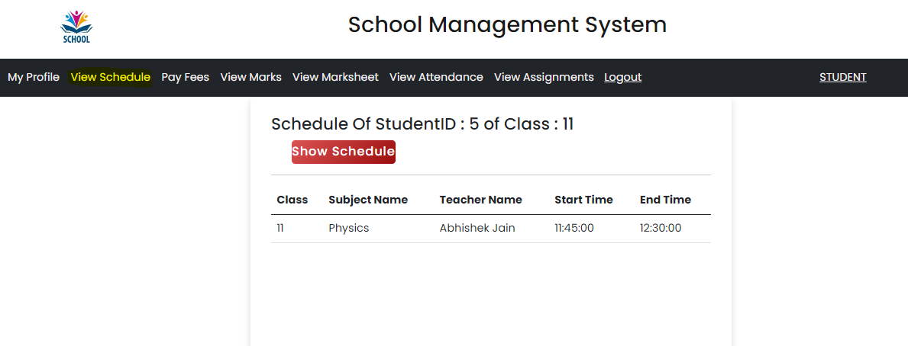

Slide 36
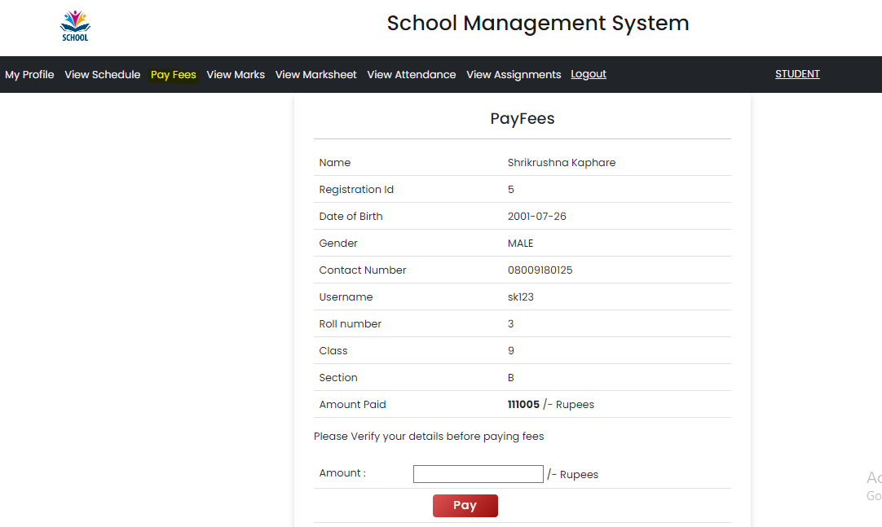

Slide 37
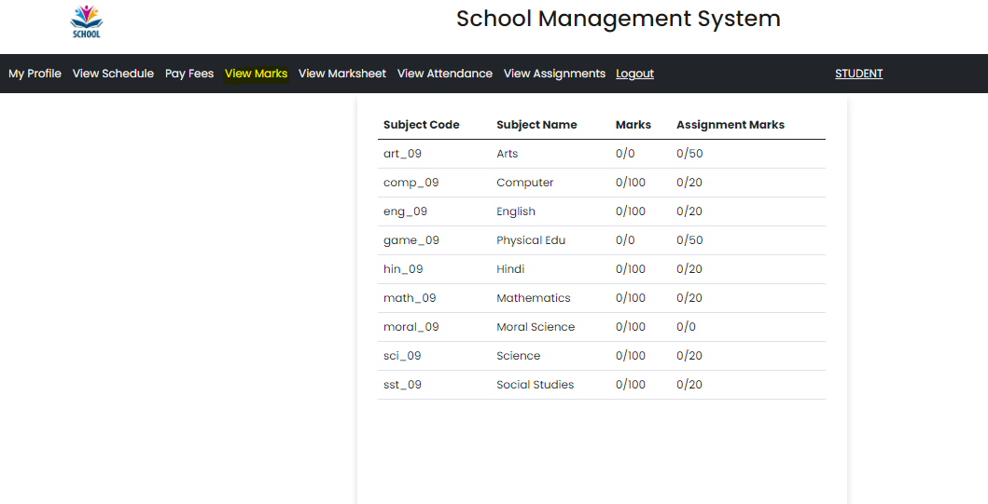

Slide 38
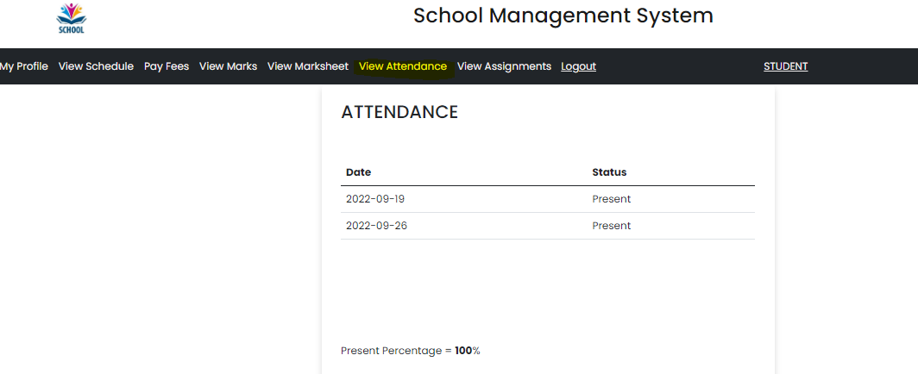

Slide 39
Teacher page flow

Slide 40
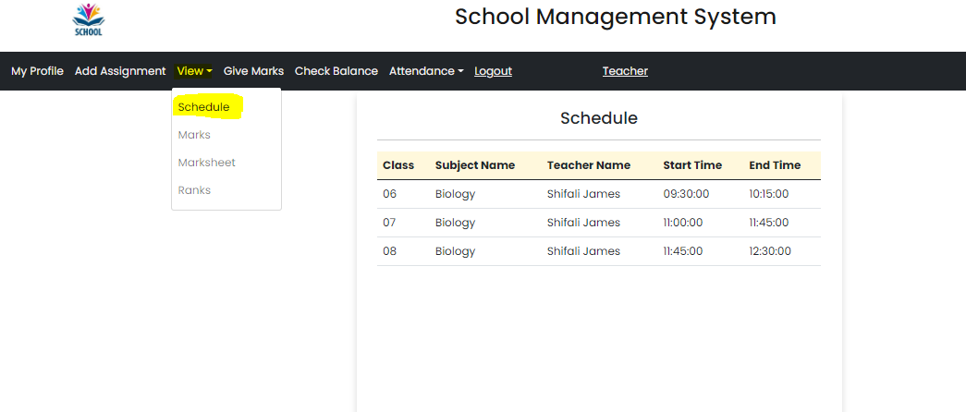

Slide 41
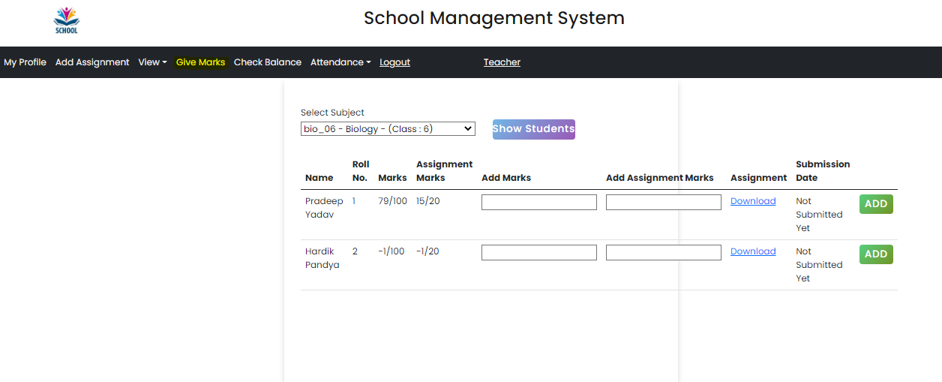

Slide 42
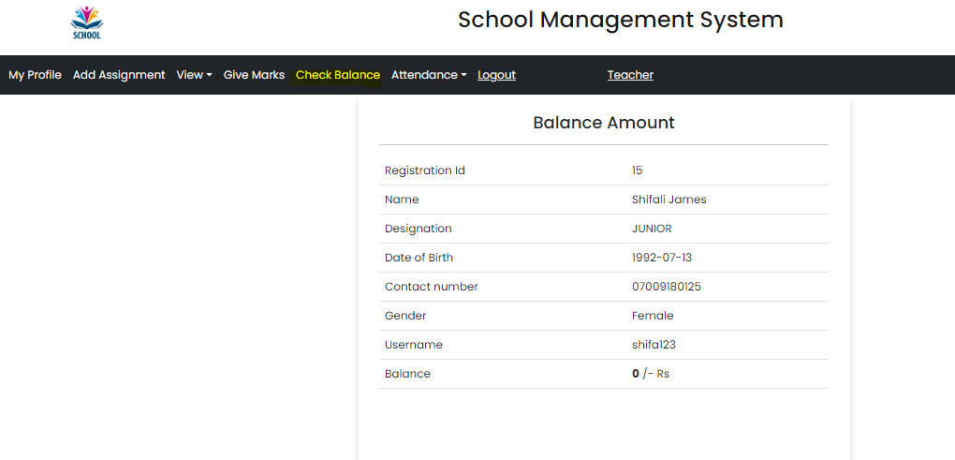

Slide 43
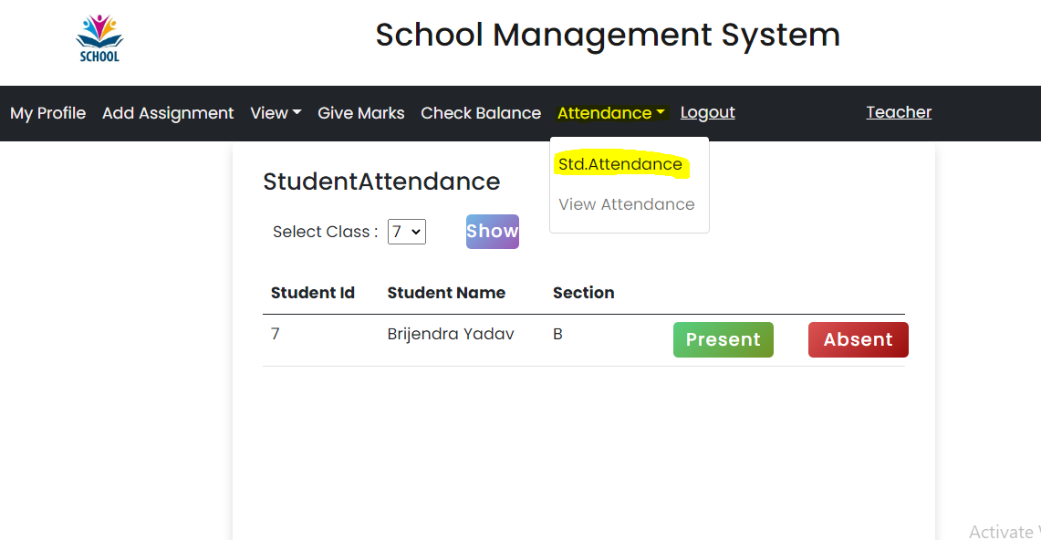

Slide 44
